Slide 1
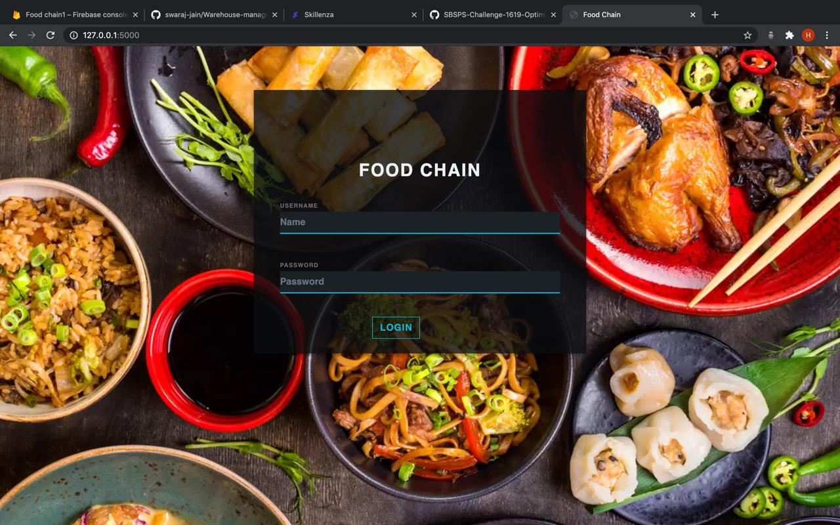
TradeMEAL
By Team Code-A-Line

Slide 2
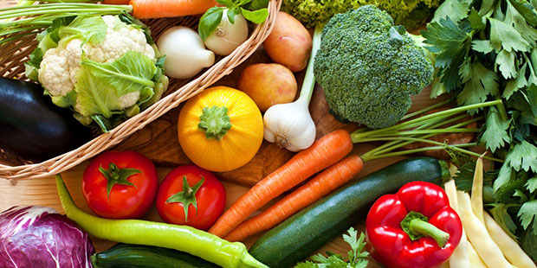
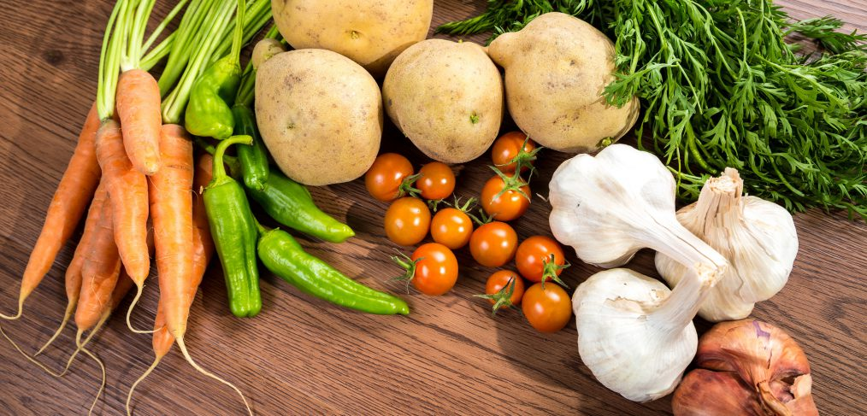
PROBLEM STATEMENT
A food delivery service has to deal with a lot of perishable raw materials which makes it all, the most important factor for such a company is to accurately forecast daily and weekly demand. Too much inventory in the warehouse means more risk of wastage, and not enough could lead to out-of-stocks - and push customers to seek solutions from your competitors. Further a lacK of communication between supplier, warehouse and client also leads to a wobbly supply chain, aggravating the situation. For food safety purposes a robust tracing technique is also required.

Slide 3
Project objective
A software prototype web app for demand forecasting, inventory management and food tracking using machine learning and blockchain.

Slide 4
Solution: An inventory tracking website
For supplier:
Communicate with warehouse about demand, transport schemes, prices and place orders.
For warehouse:
Get prediction of food demand by machine learning, communicate with both restaurants and suppliers
1
3
For restaurants:
Communicate with warehouse about their demand, costs and transportation with an option of food tracing using blockchain.
Centrally:
Food inventory managed and traced through blockchain
2
4

Slide 5
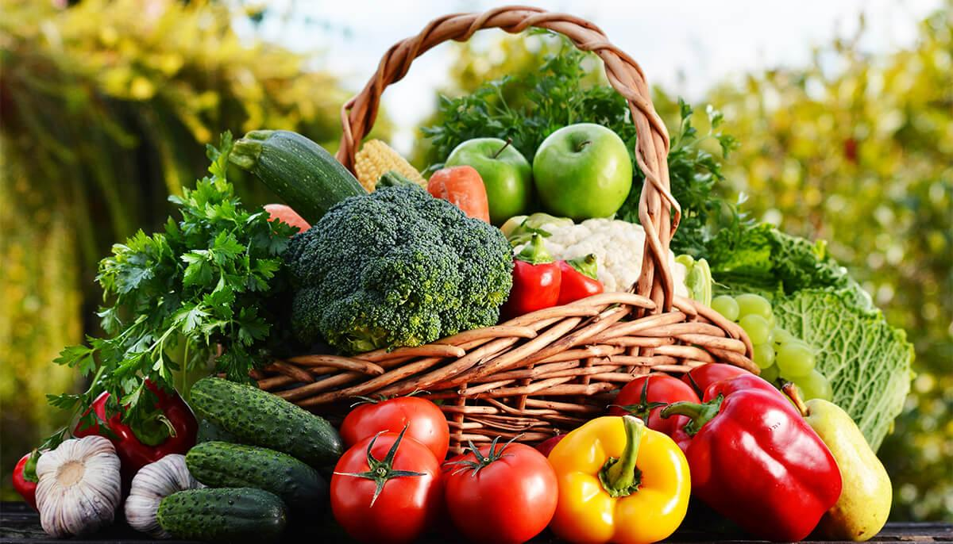

Understanding the Project
UNDERSTANDING THE PROJECT

Slide 6
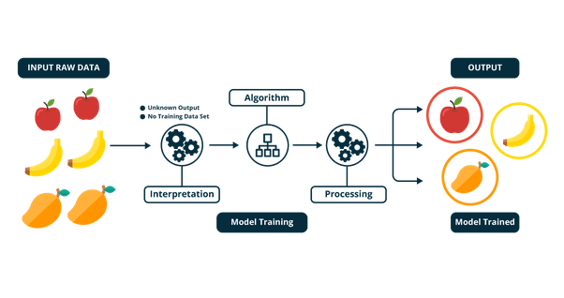
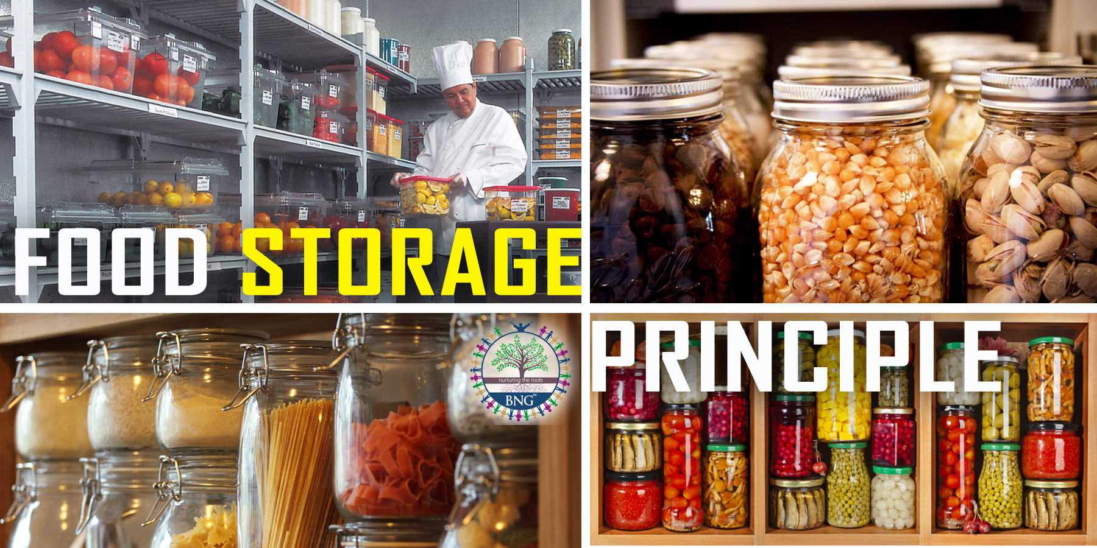
ML Solution
We divided the dataset depending upon the restaurants and cuisine types, engineer the features and run the model on it.
After a lot of training of different models and tuning the hyper parameters we settled with an ensemble of two different models.
We used a Random Forest Regressor as it didn’t overfit the data easily like KNN regressor. Also after this we change we used a time series prediction(LSTM) for individual restaurants and cuisine type for a better output.

Slide 7
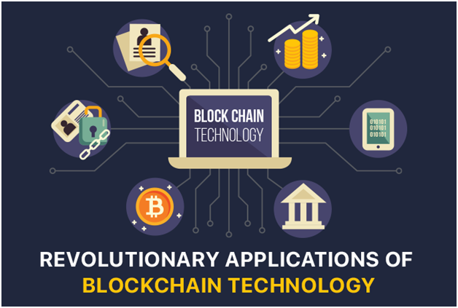
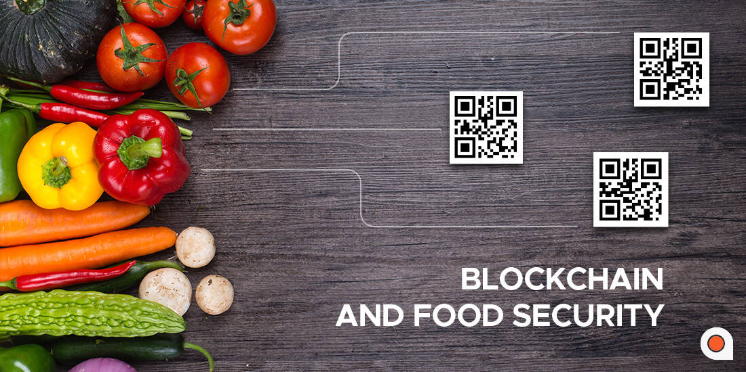
BLOCKCHAIN
Source Tracing
There has been a popular demand in recent years for people to know where their food originally comes from. Hence, for supply chain monitoring and safety, we use blockchain.
Implementation:
All essential data about the food like: from where it was supplied, how much, at what price and when it was supplied, are stored as a Block in a Blockchain, which can be mined from the user’s end, that is, the restaurant app.

Slide 8
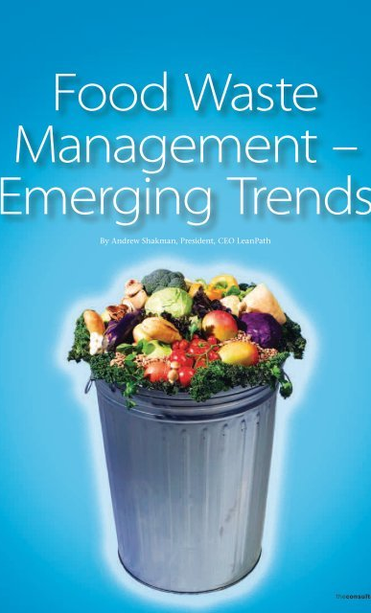
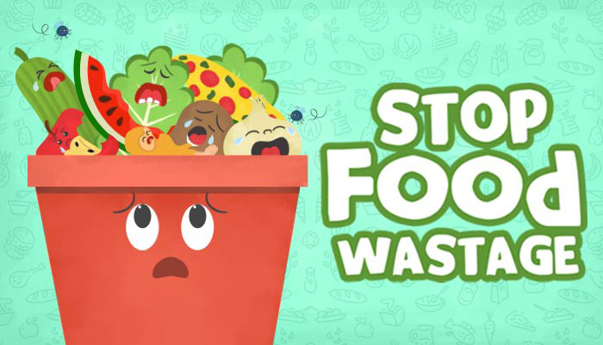
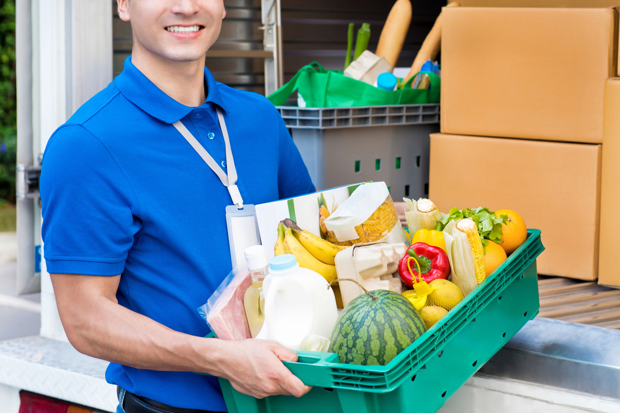
IMPACT
Excess food inventory, especially in perishable items is the cause of major food wastage. Shortage, on the other hand loses valuable clients and causes monetary losses to businesses.
01 | Waste management through inventory prediction
02 | Effortless communication with both suppliers and consumers
03 | Ability to track food source and supply chain
04 | Additional security by blockchain

Slide 9

TradeMeal is an interactive
Web application where we have
taken care of great factors like
Accuracy , scalability and interactive
As well as responsive UI .

Slide 10
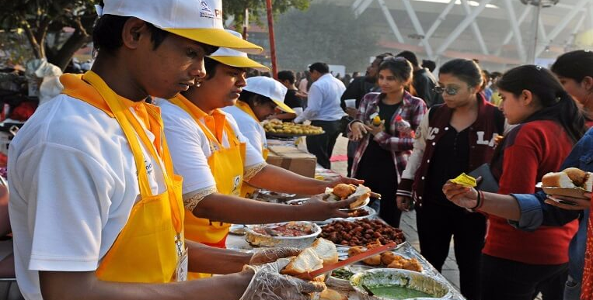
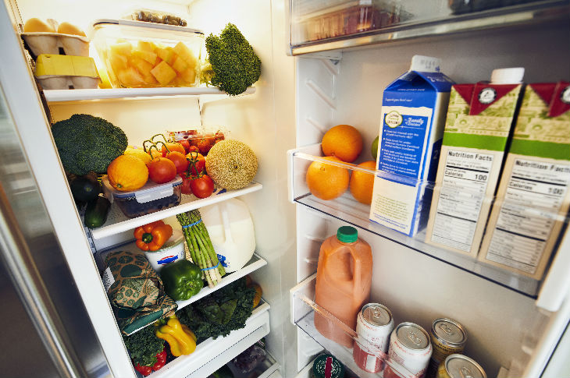
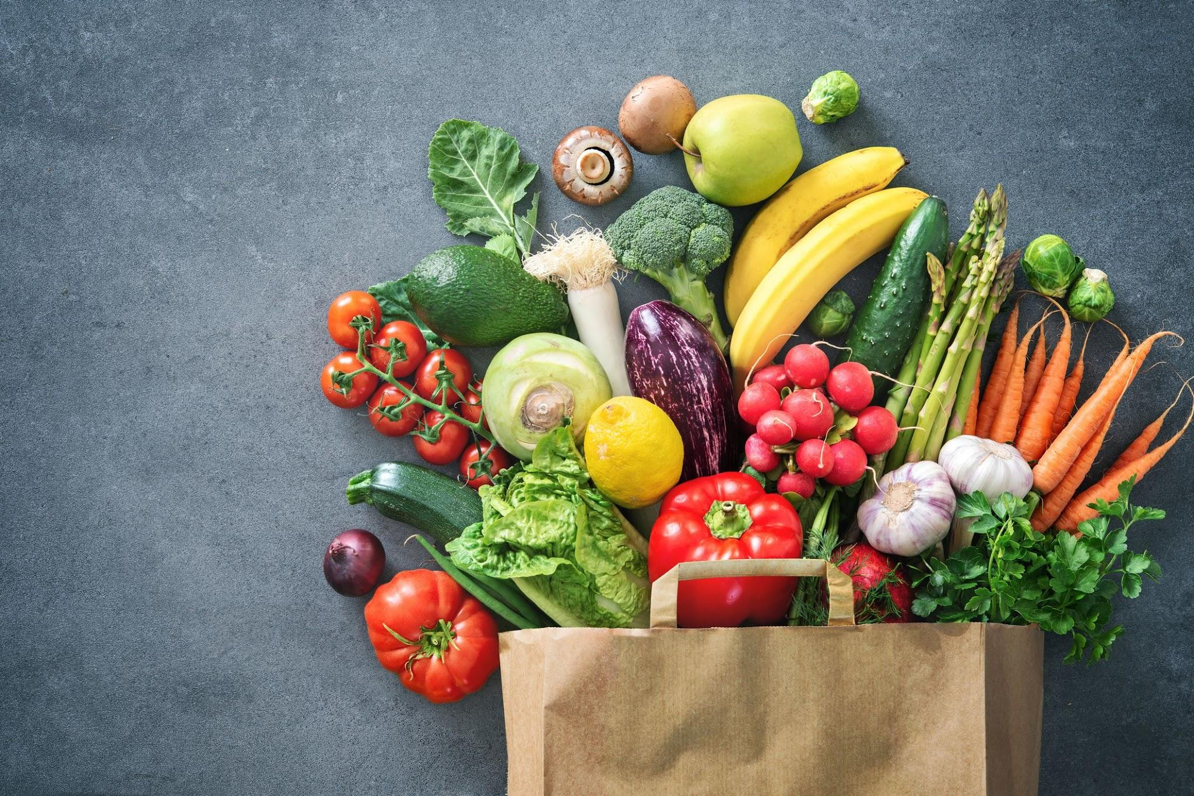
Future Of Work
Rescale application
Include Dataset with festivals
Multiple blockchain
01
03
Different clusters of warehouses, belonging to certain party can interact to further improve website functionality.
02
Various factors affect demand-supply chain, hence training our ML models on a better dataset would improve predictions.
To increase scale of application, a better blockchain would be required to deal with multiple branching and data retrieval.

Slide 11
Our Team
Shirin Kaul Swaraj Jain
Somya Jain Surya Prakash Mishra
CEO
CFO
Sales Director
Berry Books
Vinny Viewer
Wendy Writer

Slide 12
Thank you.

